Slide 1
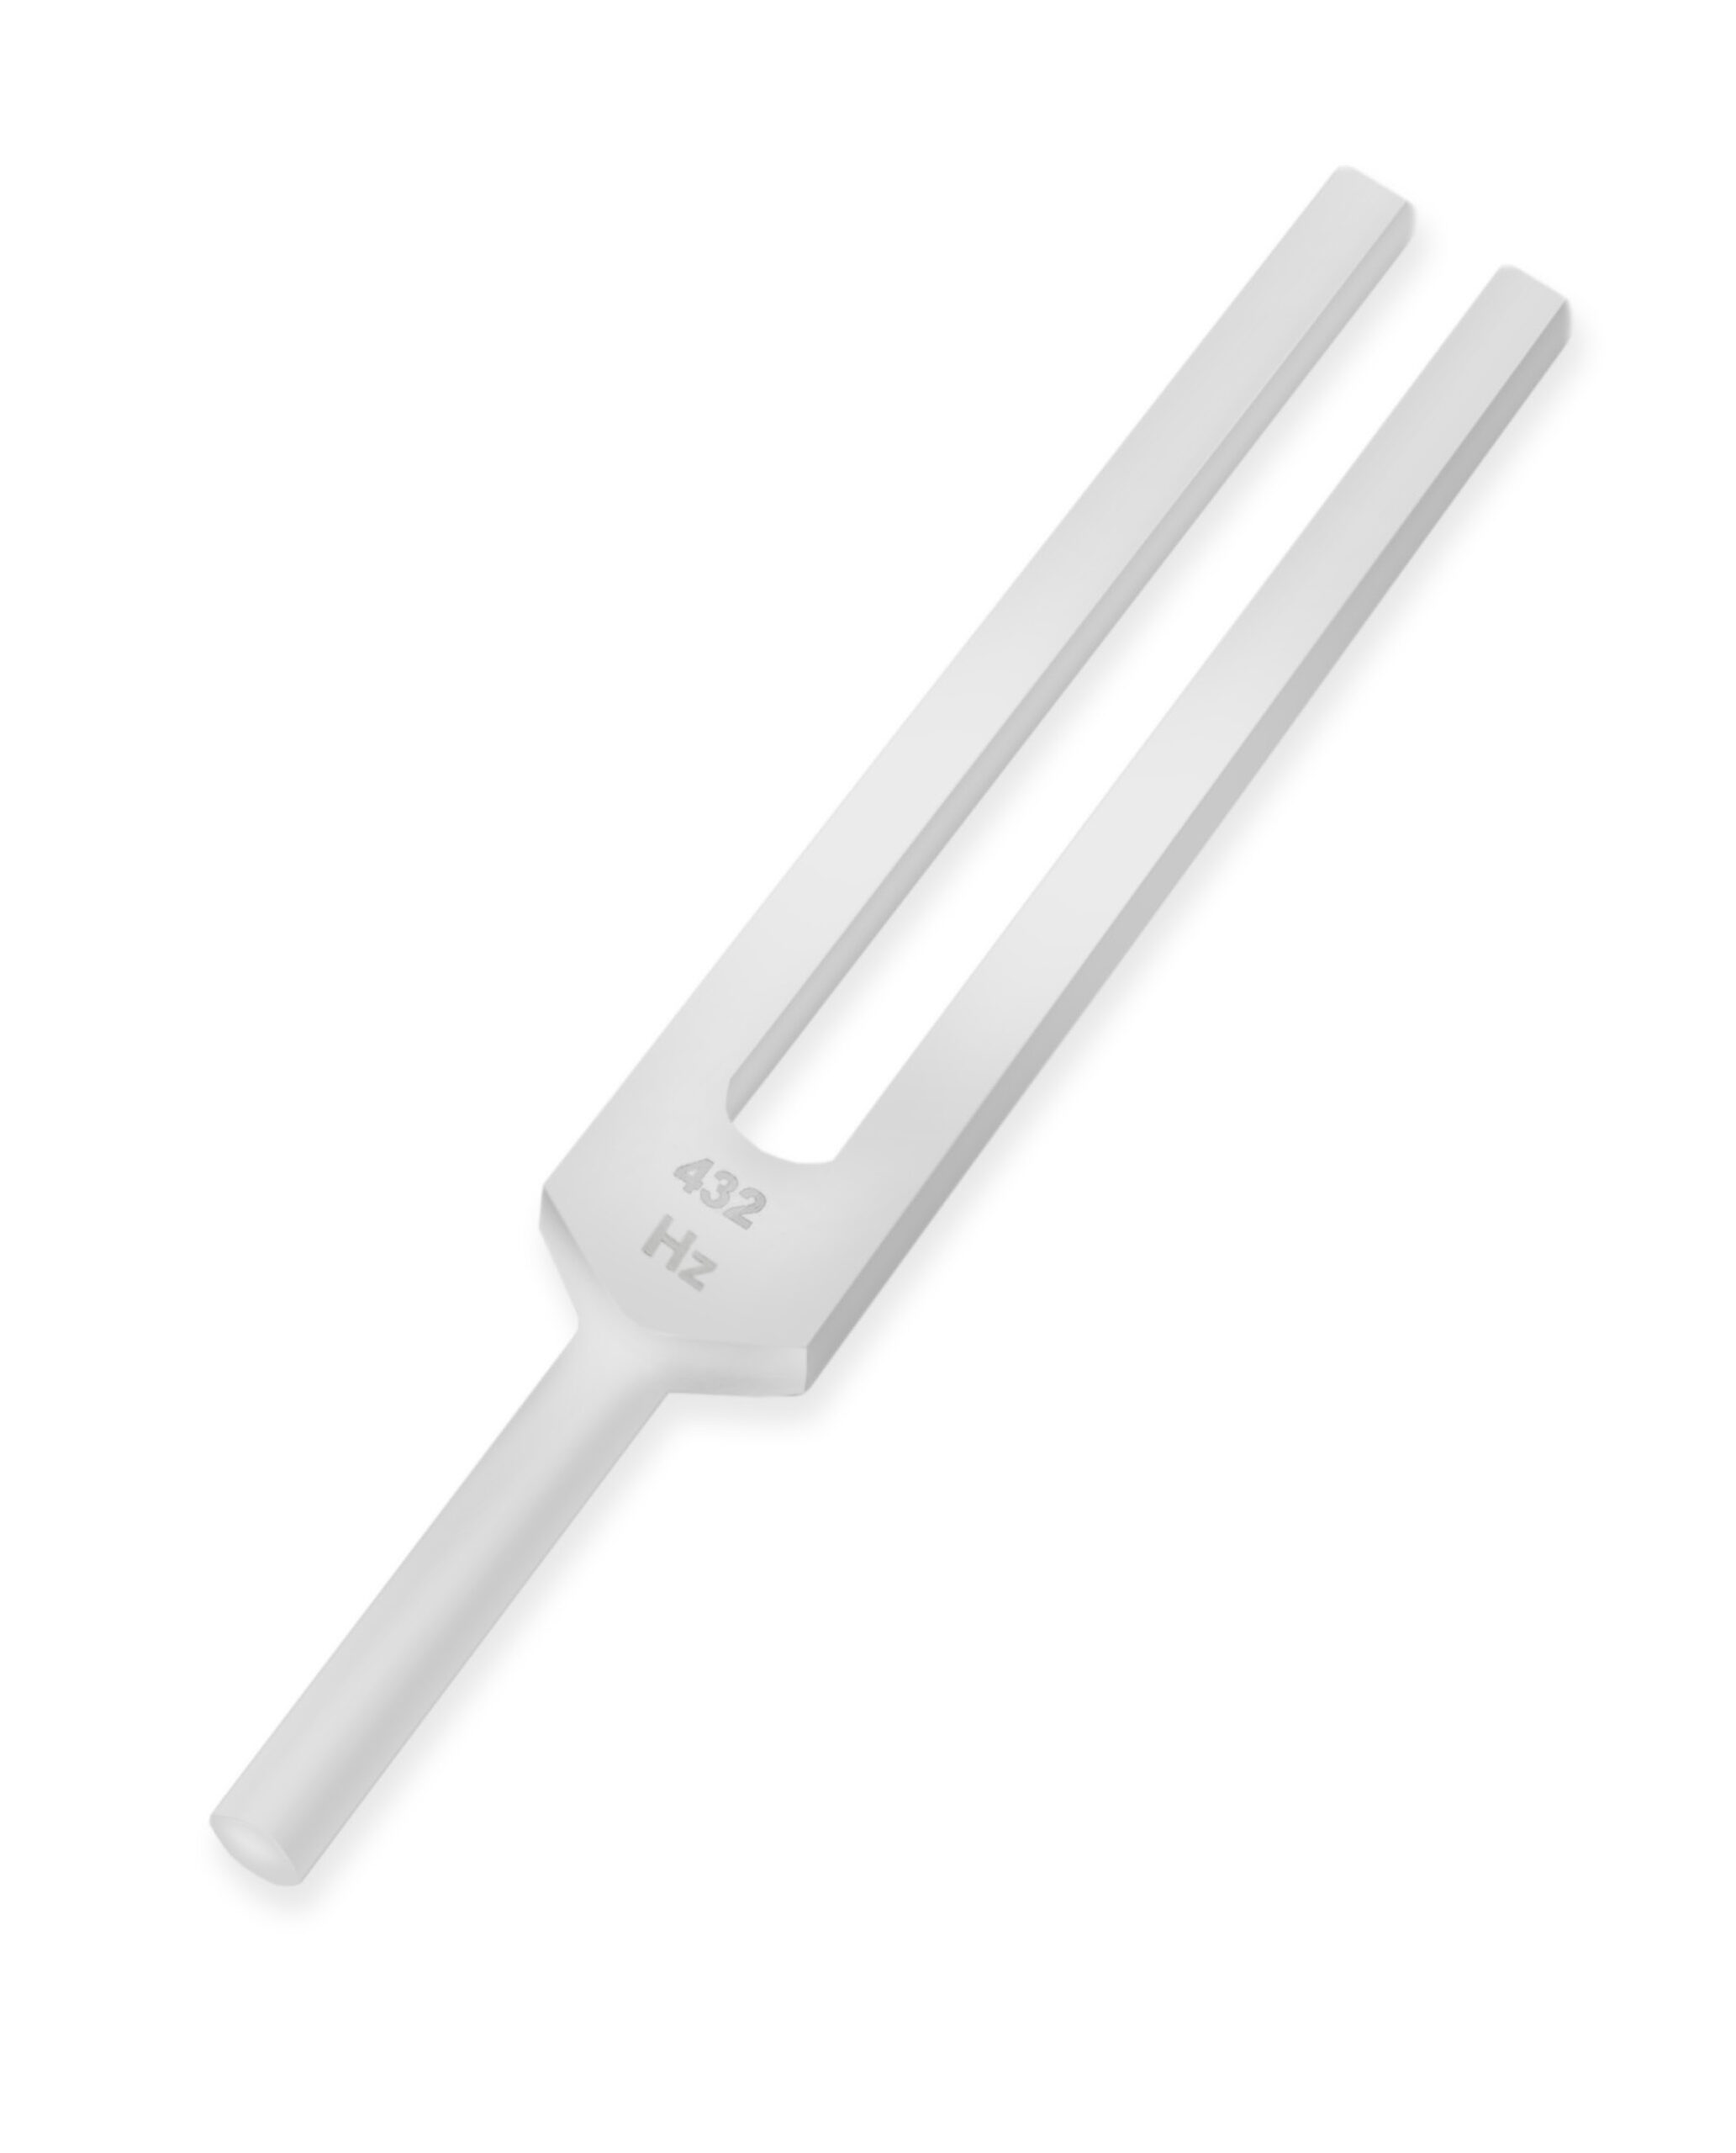
Acoustic acuity tests

Slide 2
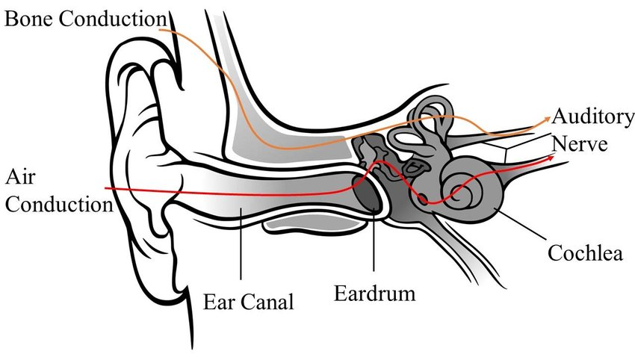
Air conduction (AC): The sound wave is collected by the ear pavilion, funneled through the external ear canal (EAC) and sets the tympanic membrane and the ossicular chain in motion.
The stapes footplate rocks back and forth and impinges upon the oval window and sets the perilymph of the inner ear in motion.
The movement of the liquids within the inner ear stimulates the hair cells and generates an electrical impulse through the auditory nerve, which will be decoded in the brain as sound information.

Slide 3
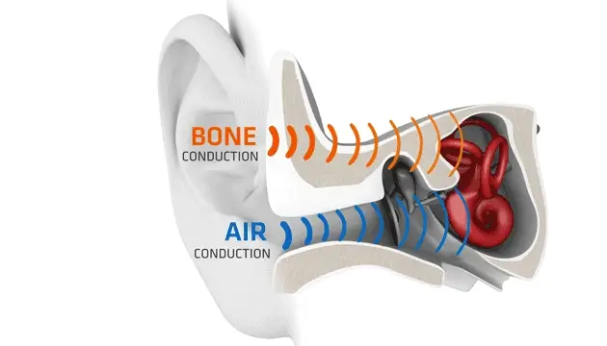
Bone conduction (BC): The sound wave sets the skull bones in motion and this vibration is transmitted directly or indirectly to the inner ear.

Slide 4
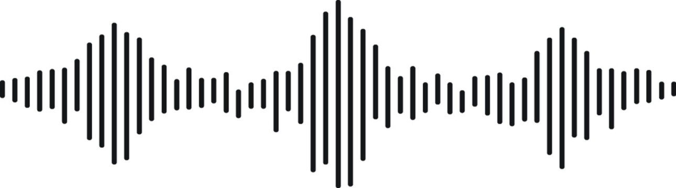
Attention! – Air conduction is always more efficient than bone conduction (AC>BC) because air is a much lower density transmission medium (lower resistance means less energy required for the same result).

Slide 5

Hypoacusis – hearing loss. Depending on the mechanism, it is classified as: conductive, sensorineural, and mixed.
Conductive hearing loss: Generated by impaired air conduction (EAC – TM – ossicular chain), or in other words, pathology of the external or middle ear
Patients may hear their voice louder (autophony) and speak more softly.

Slide 6
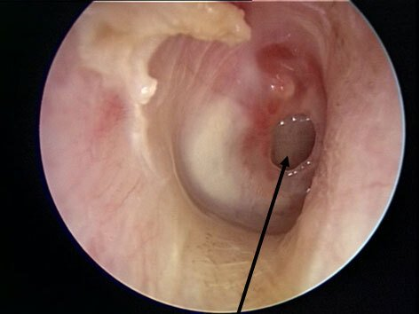
TM (tympanic membrane) perforation

Slide 7
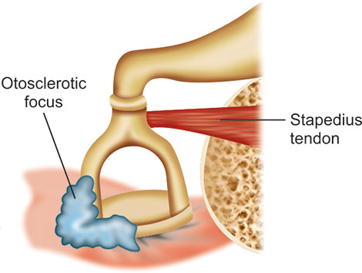
Ossicular chain afflictions

Slide 8
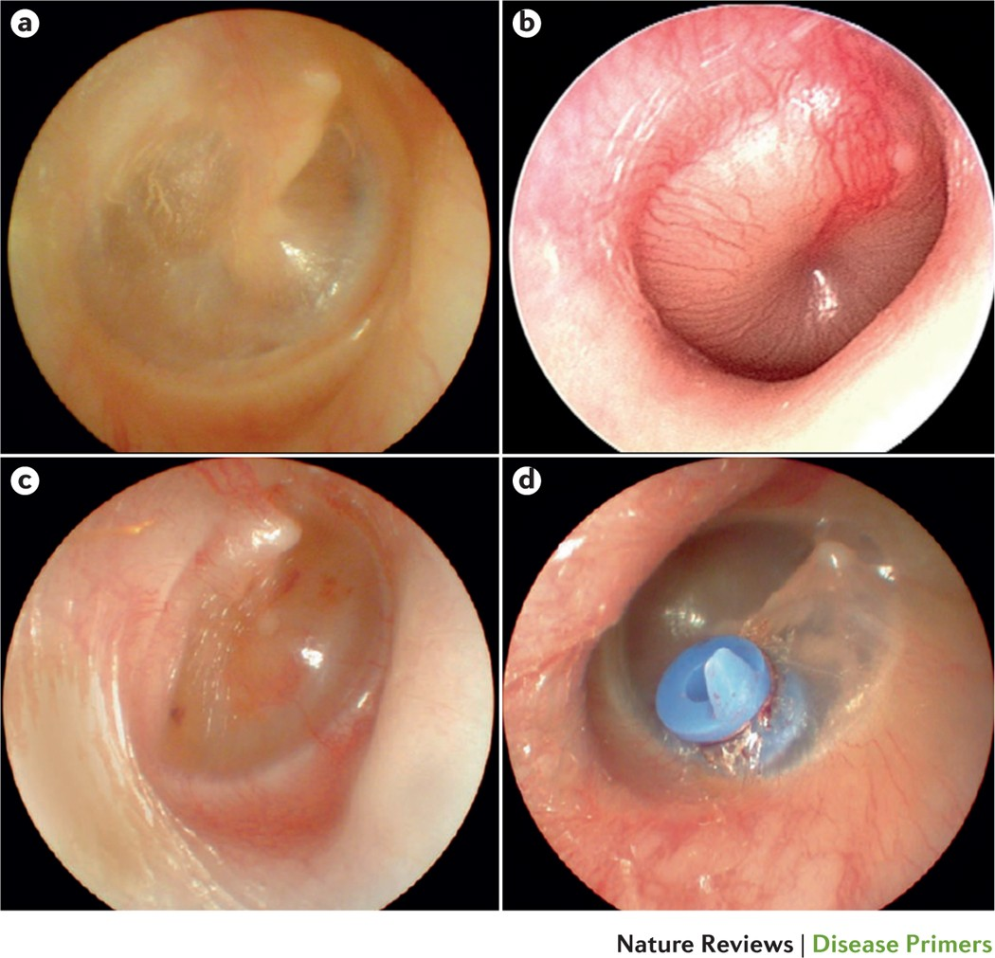
Liquid build-up in the middle ear (e.g., otitis media, Eustachian tube dysfunction)

Slide 9
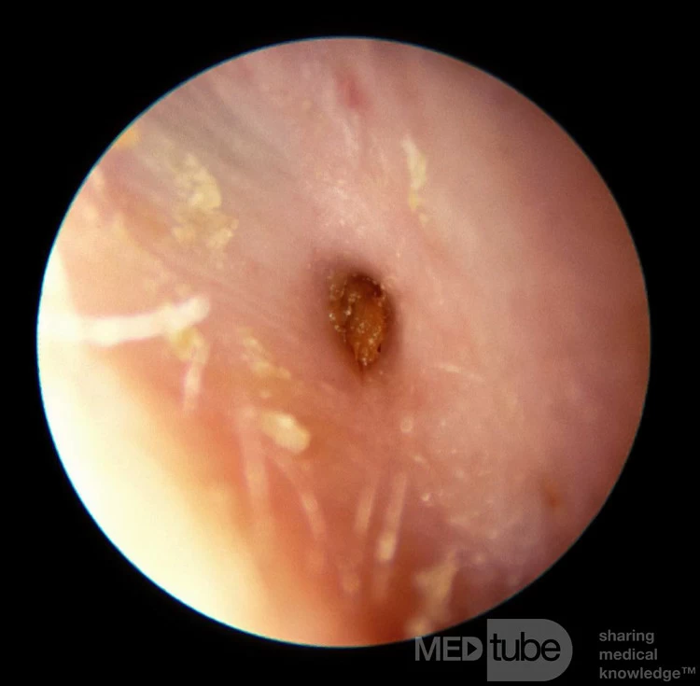
EAC stenosis

Slide 10
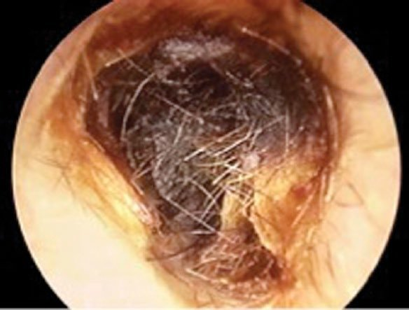
Foreign bodies in the EAC (most frequently cerumen )

Slide 11
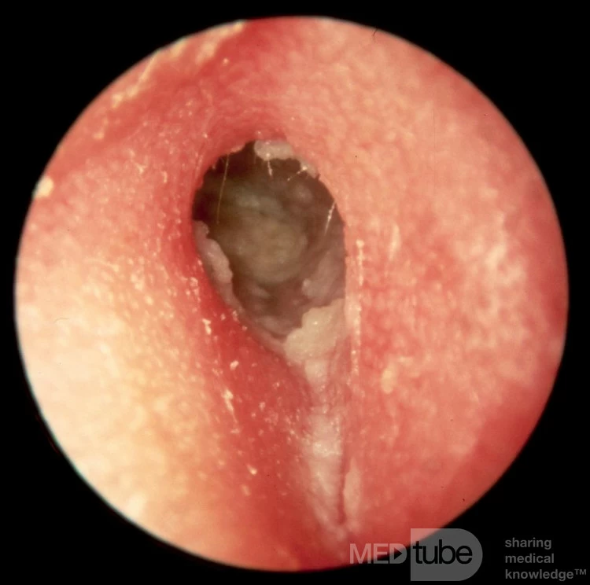
Acute inflammation (otitis externa).

Slide 12
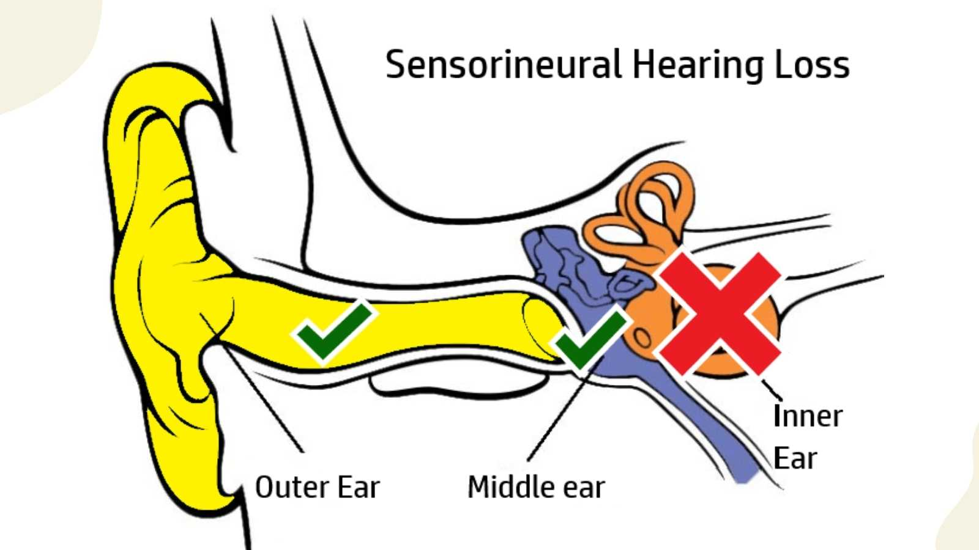
Sensorineural Hearing Loss:
Caused by damage to the inner ear (cochlea), vestibulocochlear nerve (VIII), or brain’s hearing areas.
Involves impaired bone conduction.

Slide 13

Patients may hear their voice softer and speak louder.
They may hear sounds but struggle to understand speech or detect high-pitched noises.

Slide 14
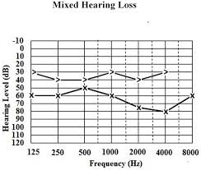
Mixed Hypoacusis:
Involves impairment of both air conduction (AC) and bone conduction (BC) in the same ear.

Slide 15
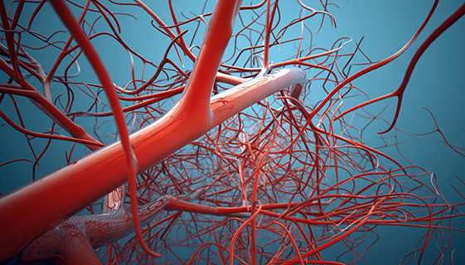
Vascular pathology
Ischemia (Inner Ear Stroke)
Atherosclerosis
Microvascular Disease
Common in conditions like diabetes and hypertension, where small blood vessels get damaged over time.
Vasculitis
Autoimmune conditions (e.g., Wegener’s granulomatosis, systemic lupus erythematosus) can inflame blood vessels, including those serving the inner ear.
Thrombosis or Embolism
Migraine-Associated Vascular Dysfunction
Some migraine patients experience auditory symptoms due to transient vascular changes in the brain and inner ear.

Slide 16
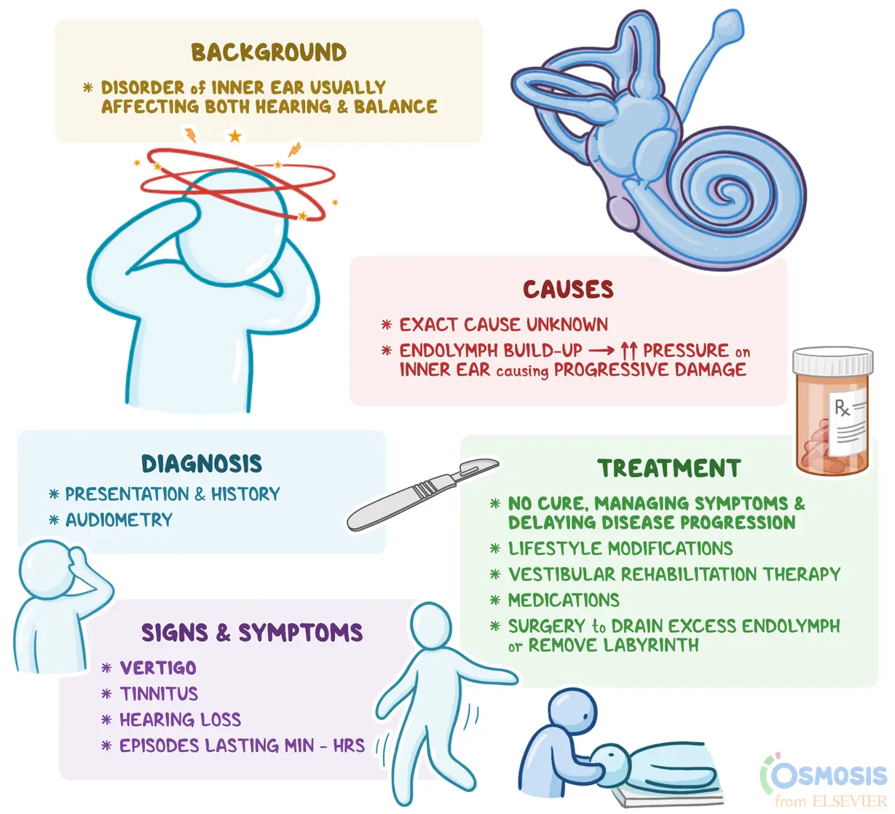
Ménière’s disease

Slide 17
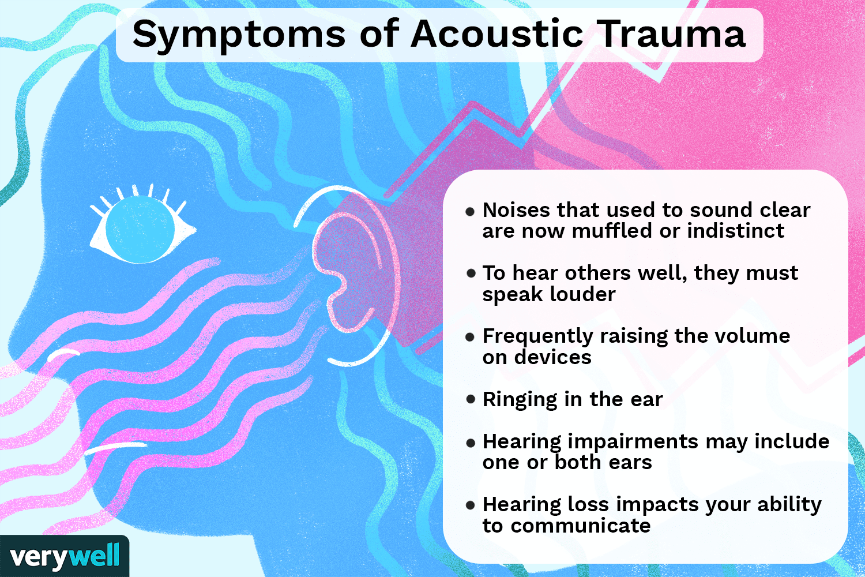

Slide 18

Presbycusis (age-related hearing loss)

Slide 19
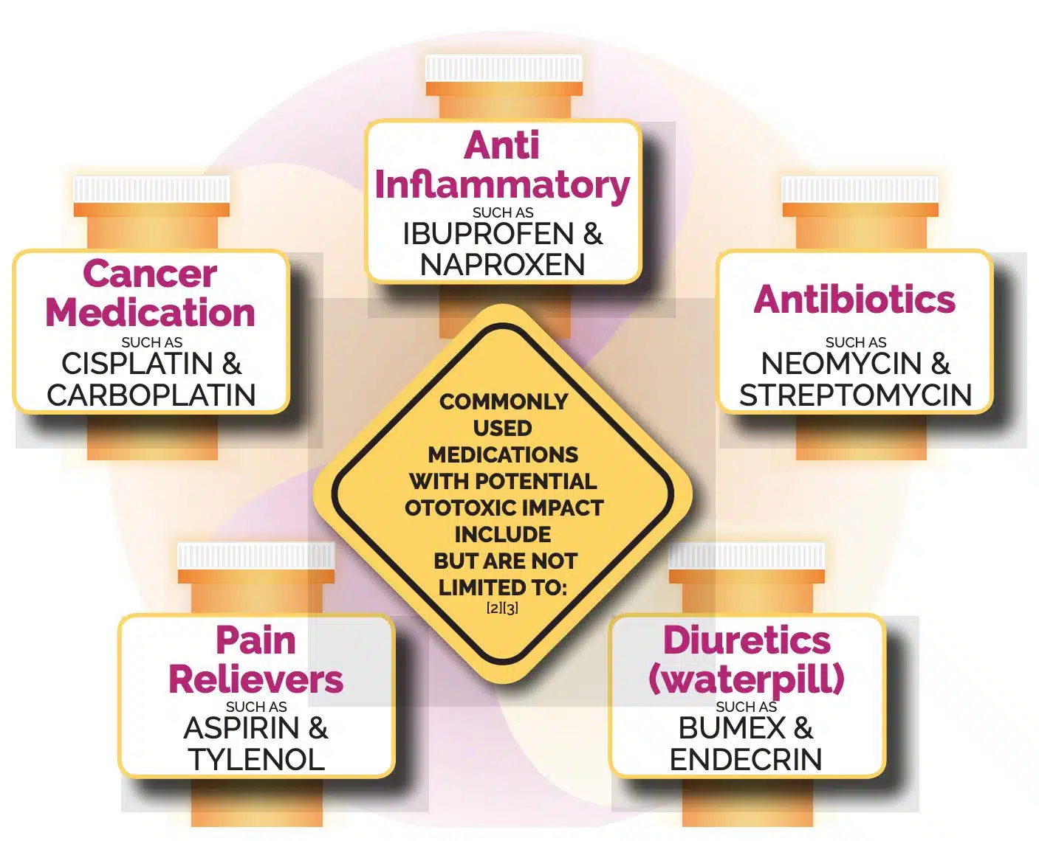
Ototoxicity

Slide 20
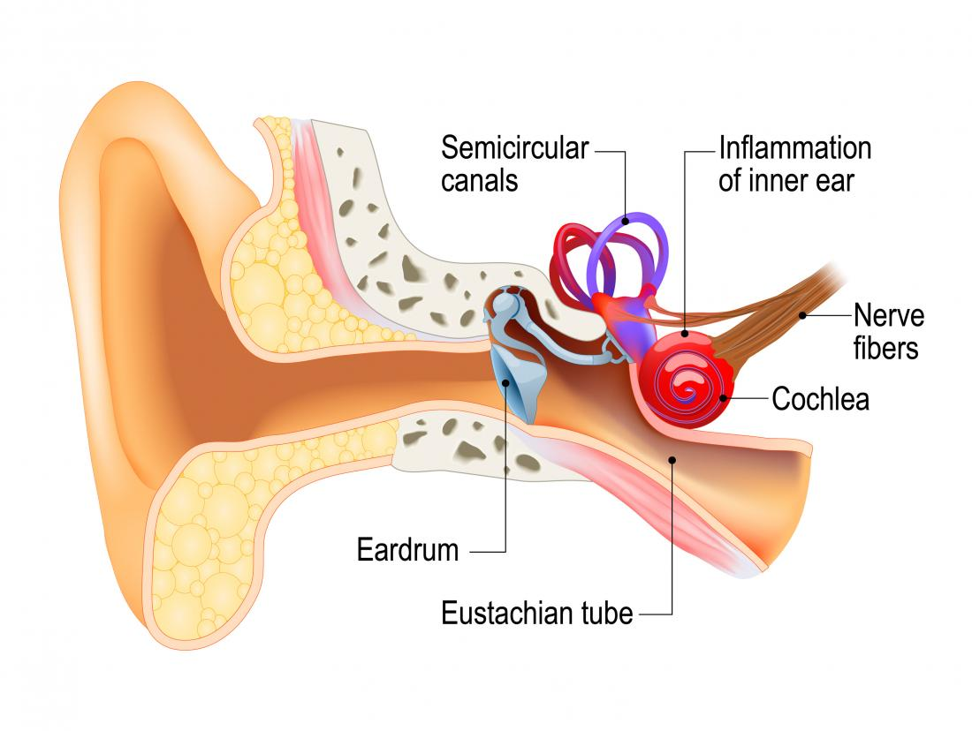
Neuronal inflammation (neuro-labyrinthitis)

Slide 21
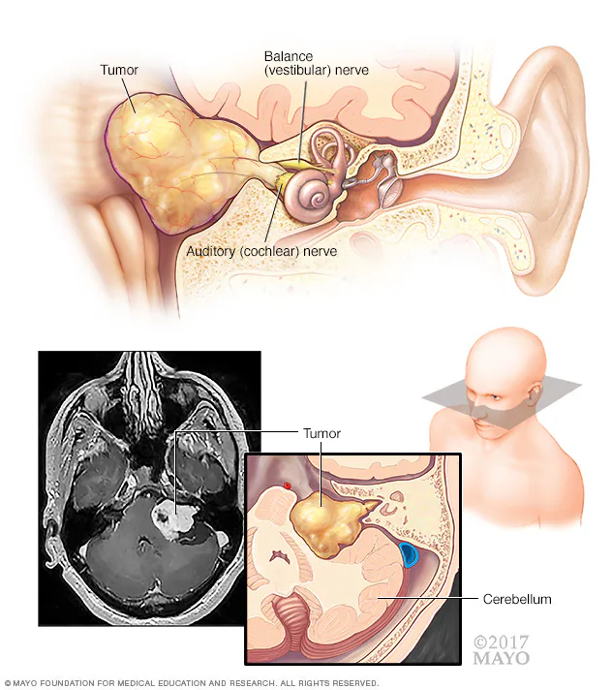
Tumors of the vestibulocochlear nerve

Slide 22
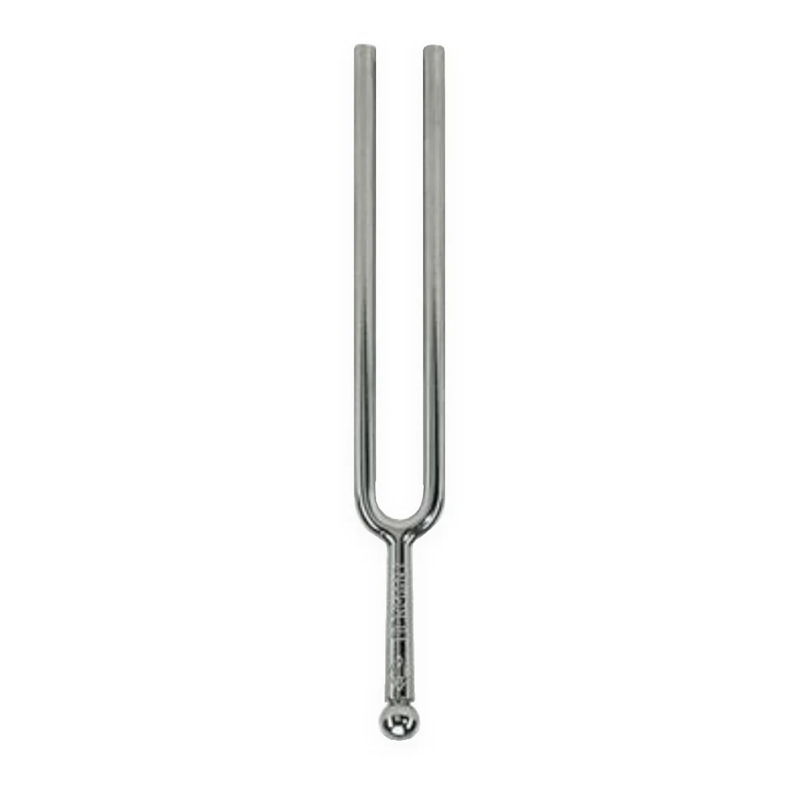
Tuning fork

Slide 23
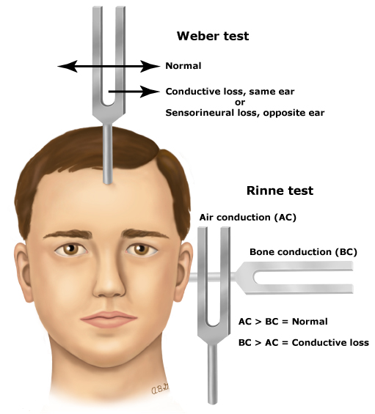
WEBER TEST
Necessary instruments: Tuning fork (frequency 250 Hz, 440 Hz or 512 Hz.)
To examine: Conductive hypoacusis vs. Sensorineural hypoacusis (orientation tests).

Slide 24
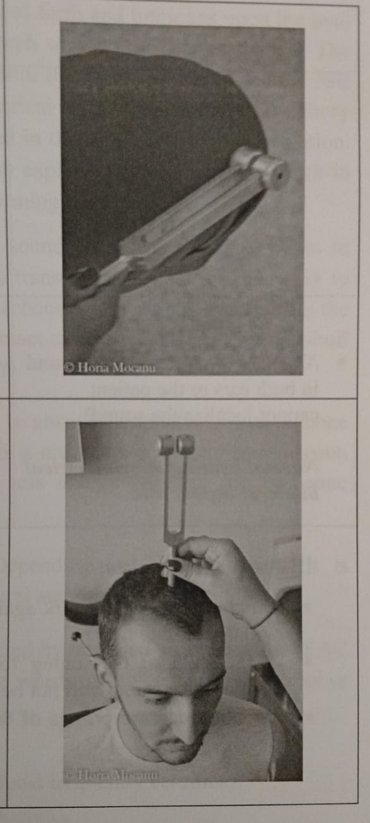
Vibrate the tuning fork by hitting it against your patella.
Place the stem of the tuning fork on the vertex. Ask patient to report in which ear the sound is heard louder.
Attention! – do not touch the prongs of the tuning fork

Slide 25
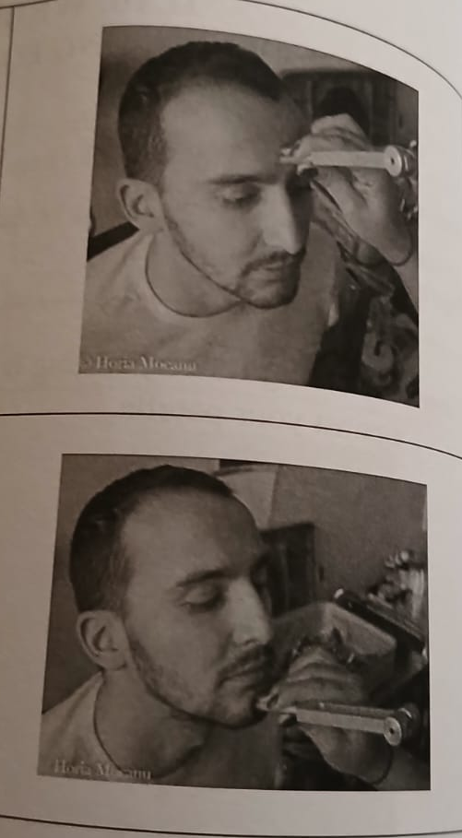
The tuning fork can also be placed on the forehead (glabella) or on the menton.
Normal aspects:
Normal Weber test (equal sound in both ears or the patient cannot localize the sound).
Normal hearing or symmetrical bilateral hypoacusis.

Slide 26
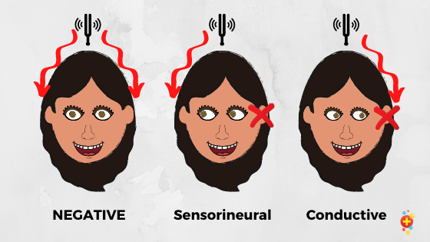
Pathological aspects:
Sound heard best in the abnormal ear → Conductive hearing loss.
Sound heard best in the normal ear → Sensorineural hearing loss.

Slide 27

Frequent mistakes:
Do not hit the tuning fork against hard surfaces (furniture) or you will decalibrate it.
If the stem of the tuning fork is not in direct contact to the cranium, the sound will not be heard.
Do not touch the prongs of the tuning fork. Hold it by the stem only.

Slide 28
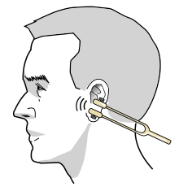
RINNÉ TEST
Necessary instruments: Tuning fork (frequency 250 Hz, 440 Hz or 512 Hz.)
To examine: Conductive hypoacusis vs. Sensorineural hypoacusis (orientation tests).

Slide 29
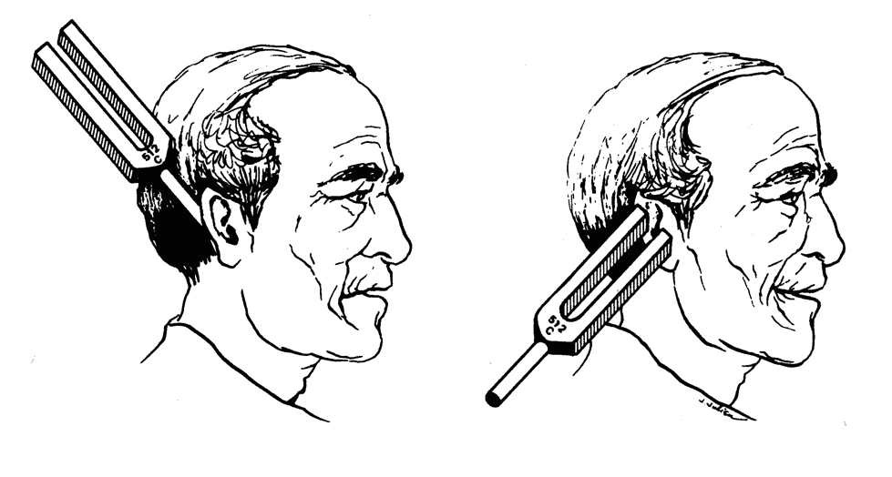
Vibrate the tuning fork by hitting it against your patella.
Place the stem of the tuning fork on the mastoid process. Ask patient if the sound is heard.
Attention! – do not touch the prongs of the tuning fork
mmediately move the tuning fork at about 1 cm. in front of the EAC and ask if the sound is lower or louder than the one on the mastoid

Slide 30
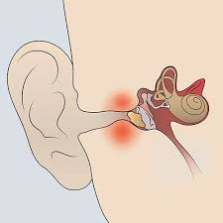
Normal aspects:
Positive Rinné (the sound is louder and longer at the EAC than on the mastoid).
→ Normal hearing
Pathological aspects:
Negative Rinné (the sound is louder and longer on the mastoid than at the EAC) → Conductive hearing loss

Slide 31
Frequent mistakes:
Do not hit the tuning fork against hard surfaces (furniture) or you will decalibrate it.
If the stem of the tuning fork is not in direct contact to the cranium, the sound will not be heard.
Do not touch the prongs of the tuning fork. Hold it by the stem.

